Slide 1

Introduction to Cloud Computing
J. Marcos Palacios, Ph.D.

Slide 2
Contents
What is Cloud Computing?
Technical Aspects
Commercial Aspects
Conclusion

Slide 3
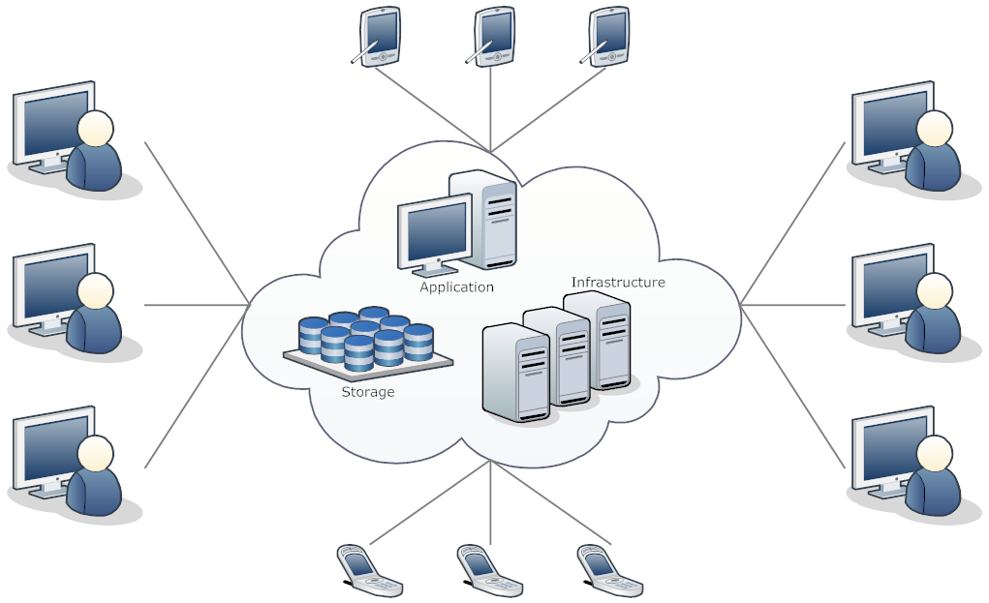
What is Cloud Computing?
Cloud Computing is a computing model that delivers services like servers, storage, networking, databases, applications, data analytics, and intelligence over the Internet.
Cloud Computing is also a networking model in which data, applications, and processing power are managed by servers on the Internet.
Users of these services pay for what they use rather than for the equipment and software needed.

Slide 4
Cloud Computing Definition
According to NIST (National Institute of Standards and Technology), the formal definition of Cloud Computing is the following:
"Cloud Computing is a model for enabling ubiquitous, convenient, on-demand network access to a shared pool of configurable computing resources (e.g., networks, servers, storage, applications, and services) that can be rapidly provisioned and released with minimal management effort or service provider interaction."

Slide 5
Technical Aspects

Slide 6
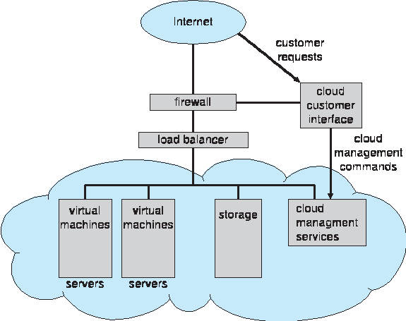
Cloud Computing Architecture
Physical hardware in provider's data centers
Cloud management software
Virtual Machine Managers
Load balancers
Firewalls
Web browser-based cloud UI

Slide 7
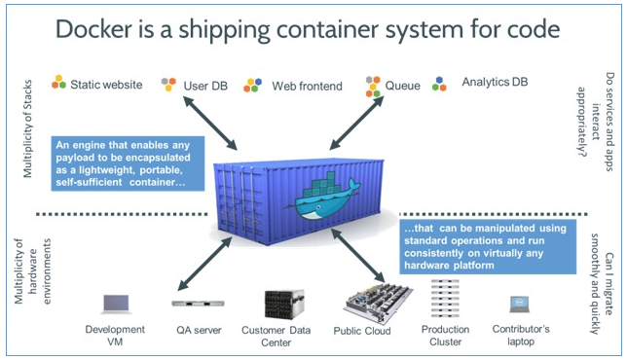
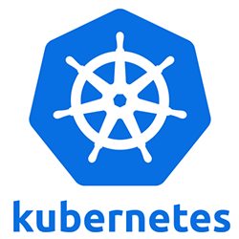
Cloud Computing Technologies
Containers and Images
A Docker container image is a lightweight, standalone, executable package of software that includes everything needed to run an application: code, runtime, system tools, system libraries and settings.
Container Orchestration
Kubernetes is an open-source system for automating deployment, scaling, and management of containerized applications.

Slide 8
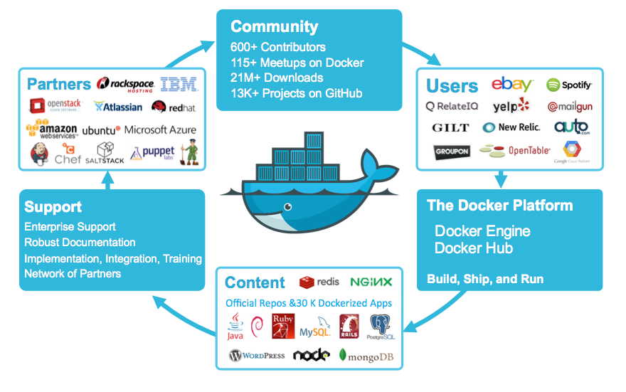
Docker Ecosystem

Slide 9
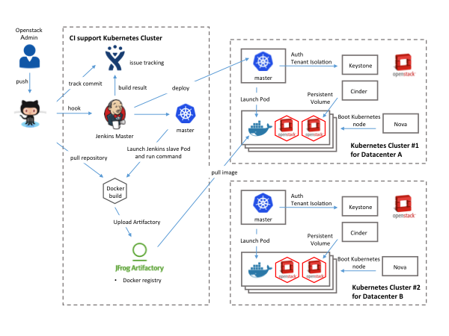
Example of App Deployment to a Cloud

Slide 10
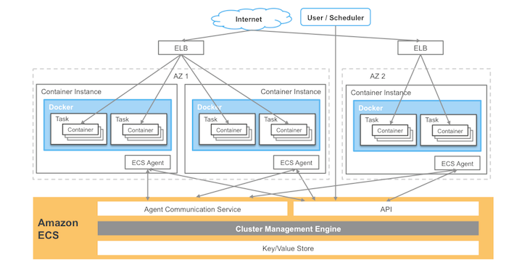
Amazon ECS Components
Amazon ECS

Slide 11
Introduction to Apache Mesos
When we install and setup a physical machine, we generally use if for very specific purposes. Some of the apps might not be using all the system resources (CPU, memory) and some might be starving for more. Therefore, it would be helpful to have the ability to combine all the physical resources across all the machines and execute tasks on specific machines, based on the resource requirements. Apache Mesos was created with this in mind, so that we can optimally use the resources available.
Apache Mesos helps us treat a cluster of nodes as one big computer, which manages CPU, memory, and other resources across a cluster. Mesos provides functionality that crosses between Infrastructure as a Service (IaaS) and Platform as a Service (PaaS). It is an Open Source Apache project.

Slide 12
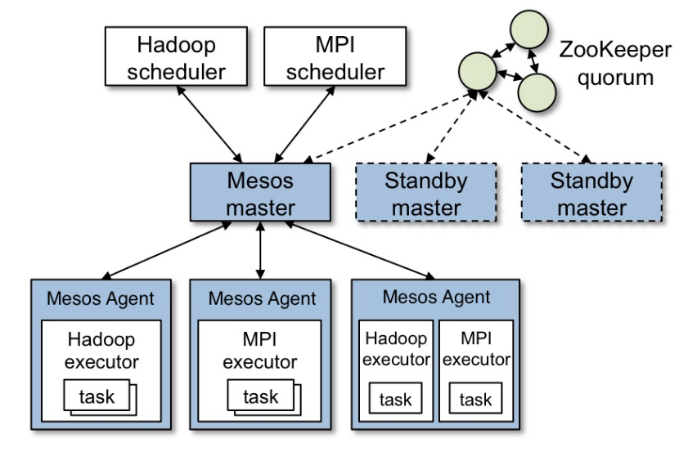
Apache Mesos Components

Slide 13
Commercial Aspects

Slide 14
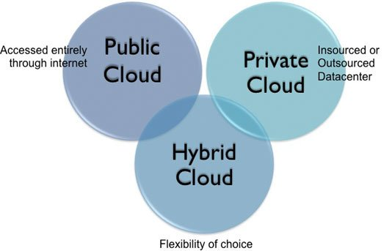
Types of Clouds
Clouds can be of three types:
Private Cloud
Public Cloud
Hybrid Cloud

Slide 15
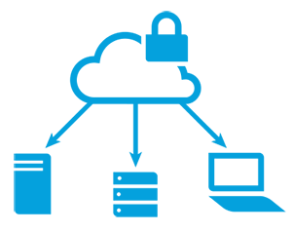
Private Cloud
A private cloud is infrastructure operated solely for a single organization, whether managed internally or by a third party.
A private cloud can be physically located on the company’s on-site data center. Some companies also pay third-party service providers to host their private cloud. With greater visibility and control into the infrastructure, organizations can operate compliance-sensitive IT workloads without compromising on security and performance.

Slide 16
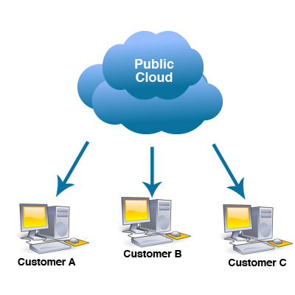
Public Cloud
Public cloud refers to the cloud computing model in which IT services are delivered across the Internet.
With a public cloud, all hardware, software, and other supporting infrastructure is owned and managed by the cloud provider, users don’t need to purchase them.

Slide 17
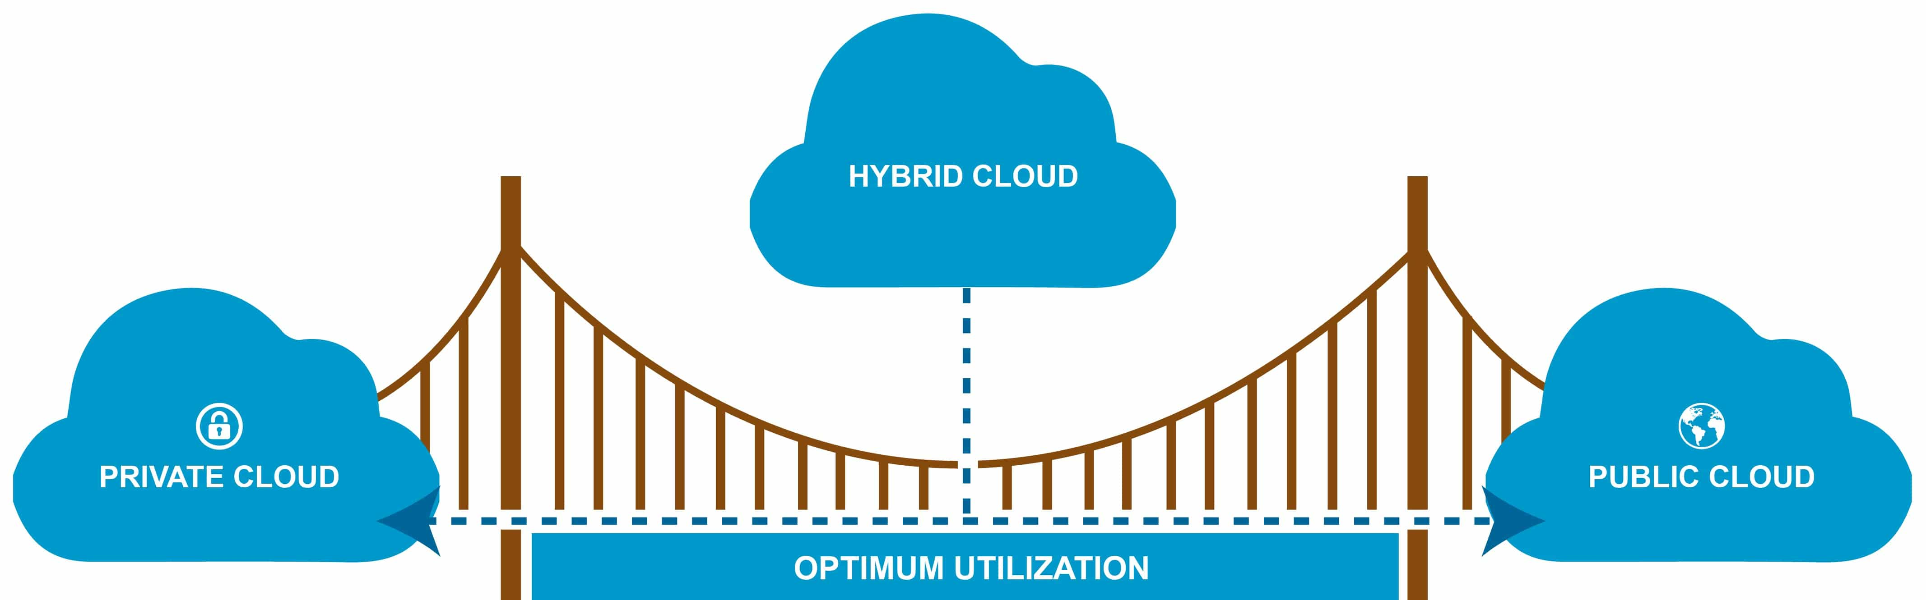
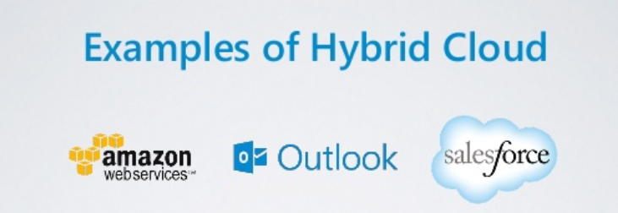
Hybrid Cloud
Hybrid clouds combine public and private clouds, bound together by technology that allows data and applications to be shared between them.
By allowing data and applications to move between private and public clouds, a hybrid cloud gives businesses greater flexibility, more deployment options, and helps optimize existing infrastructure, security, and compliance.

Slide 18
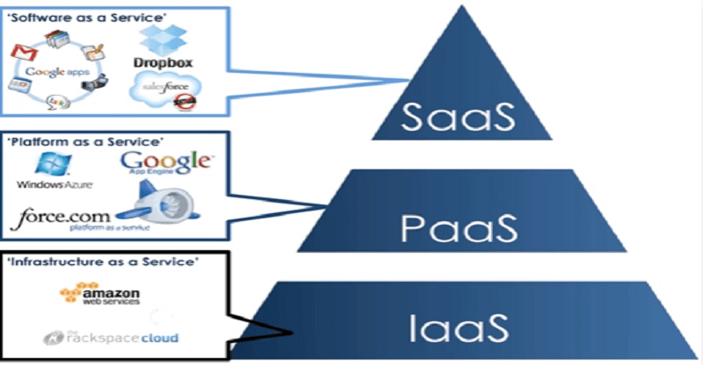
Types of Cloud Services
Cloud Computing services fall into three categories:
Software as a Service (SaaS)
Platform as a Service (PaaS)
Infrastructure as a Service (IaaS)

Slide 19
Software as a Service (SaaS)
Software as a Service is a method for delivering software applications over the Internet, run on distant computers “in the cloud” on demand and typically on a subscription basis.
With SaaS, cloud providers host and manage the software application and underlying infrastructure, and handle any maintenance, like software upgrades and security patching. Users connect to the application over the Internet, usually with a web browser on their phone, tablet, or PC.
Google Apps, Microsoft Office 365, Amazon Prime

Slide 20
Software as a Service (SaaS)
Benefits of SaaS
You can sign up and rapidly start using apps.
Easier group collaboration.
Apps and data are accessible from any connected computer.
No data is lost if your computer breaks, as data is in the cloud.

Slide 21
Platform as a Service (PaaS)
Platform as a Service refers to cloud computing services that supply an on-demand runtime environment for developing, testing, delivering, and managing software applications.
PaaS is designed to make it easier for developers to quickly create web or mobile apps, without worrying about setting up or managing the underlying infrastructure of servers, storage, network, and databases needed for development.
Cloud Foundry, OpenShift, The Heroku Platform

Slide 22
Platform as a Service (PaaS)
Benefits of PaaS
Develop applications and get to market faster.
Deploy new web applications.
Reduce complexity with middleware as a service.

Slide 23
Infrastructure as a Service (IaaS)
Infrastructure as a Service is a demand-scalable service that provides companies with computing resources including servers, networking, storage, virtual machines and data centers from a cloud provider on a pay-per-use basis.
Amazon EC2, Microsoft Azure, Google Compute Engine
Benefits of IaaS
No need to invest on hardware for services.
Infrastructure scales on demand to support dynamic workloads.
Flexible, innovative services available on demand.

Slide 24
Advantages & Disadvantages

Slide 25
Advantages
Reduced maintenance and software cost
Assured BCM (Business Continuity Management)
Improved performance
Instant software updates
Unlimited storage capacity
Increased data reliability
Universal document access
Enhanced security

Slide 26
Disadvantages
Does not work well with low-speed internet connection
Features may be limited
Locked on software versions
Requires a constant internet connection
Terms and conditions dictated by provider

Slide 27
Conclusion
Cloud Computing is off-premise computing which accommodates multiple users while ensuring the privacy and security of their data.
Not all clouds are the same and not one type of Cloud Computing is right for everyone.
Several different types and services have evolved to offer the right solution for customer needs.

